Slide 1
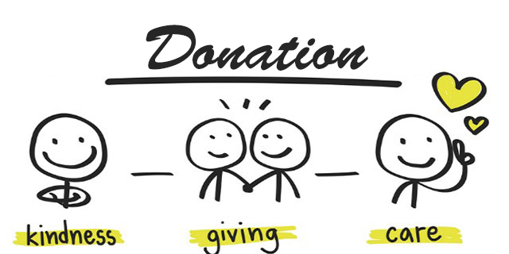
DONATION MANAGEMENT SYSTEM

Slide 2

ABC UNIVERSITY
Guided By: Presented By:
Prof. AAAAAAAAAAA BBBBBBBBB
CCCCCCCCC

Slide 3
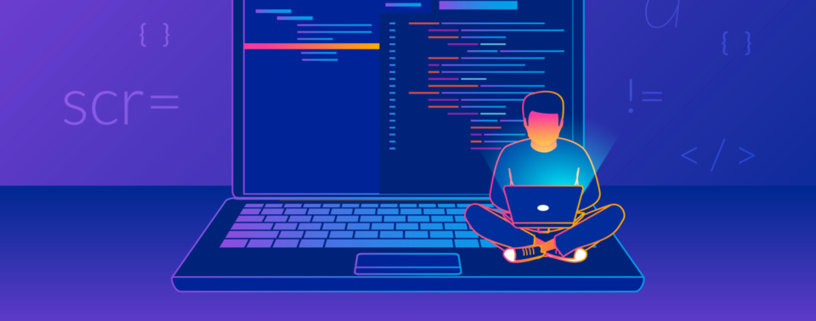
DEVELOPERS
BBBBBBBBB
cccccccccccccc

Slide 4
Introduction
Donation Management Project System is a mission to end hunger and no wasting of food and other needy items to make a hungry-free world.
In the current working scenario , many NGOs are struggling with some issues mainly communication with their member , heads and volunteer while NGO are donating.
The focus of this project is to reduce the amount of wastage of needy items and being used to the needy people.

Slide 5
Existing System
Presently people who wish to donate items need to personally visit the organizations and donate foods or other items. Otherwise, they have to search for some websites to donate needy items. In general, the large manufacturers, wholesalers, and organized community provide food items to food banks or waste tons of foods daily. They have to search for some organization that needs food. This process involves a lot of time to contact the organization to check the requirement. If they do not need the food, then the person has to contact another organization. This makes the donor tired and exhausted.

Slide 6
Advantages of Proposed System
The objective of our application is to enable a link of communication and interactions among Volunteers, donors and the needy.
The people wishing to donate will be able to see all the options available with them to do the same. The item they wish to donate then shall be collected by a volunteer who is selected by admin.
The donated item shall safely reach the intended needy persons after this interaction.
It is very much flexible to work.
Man power required is very less.

Slide 7
Objective
Reduce lack of awareness.
Enable easy interaction between donor and volunteer.
It is very much faster than manual system.
Easy and fastest record finding technique.
It is very much flexible to work.
It is very user oriented.
Data can be stored for a longer period.

Slide 8
Need of The System
There is always a need of a system that will provide an interactive platform between donors and NGOs(Volunteers). This system will reduce the manual operation required to collect donations. And also generates the various reports for analysis.
Thus, there is a big need of an online donation management system, which provides all the above- mentioned facilities and many more.

Slide 9
Project Scope
The project has a wide scope, as it is not intended to a particular organization. This project is going to develop generic software, which can be applied by any businesses organization. More over it provides facility to its users. Also the software is going to provide a huge amount of summary data.

Slide 10
Proposed System
The development of the new system contains the following activities, which try to automate the entire process keeping in view of the database integration approach.
User friendliness is provided in the application with various controls.
The system makes the overall project management much easier and flexible.
There is no risk of data mismanagement at any level while the project development is under process.
It provides high level of security with different level of authentication.

Slide 11
Modules:
In this project, we use Python and Sqlite database. It has three modules
1. Donor
2. Volunteer
3. Admin

Slide 12
Donor Modules:
Add Donation Detail
View Donation History
Edit Profile
Change Password

Slide 13
Volunteer Modules:
View Donation Collection Request
Update Donation Status and Remark
View Donation History
Edit Profile
Change Password

Slide 14
Admin Modules:
Admin is the super user of the website who can manage everything on the website. Admin can log in through the login page
Dashboard: In this section, admin can see all detail in brief like the total new donation request, Total accepted donation, Total donation delivered, Total donors , Total volunteers and Total donation area.
View All New Donation Request.
Accept or Reject Donation
Assign Volunteer and Donation Area

Slide 15
Admin Modules (Continue):
Manage Donors.
View New Volunteer Registration Request.
Accept or Reject Volunteer.
Manage Volunteer.
Admin can also update the password.

Slide 16
SOFTWARE USED
PYTHON INTERPRETER
PYCHARM IDE (INTEGRATED DEVELOPMENT ENVIRONMENT)
DJANGO FRAMEWORK
NOTEPAD++ OR ANY OTHER TEXT EDITOR
CHROME OR ANY OTHER BROWSER

Slide 17
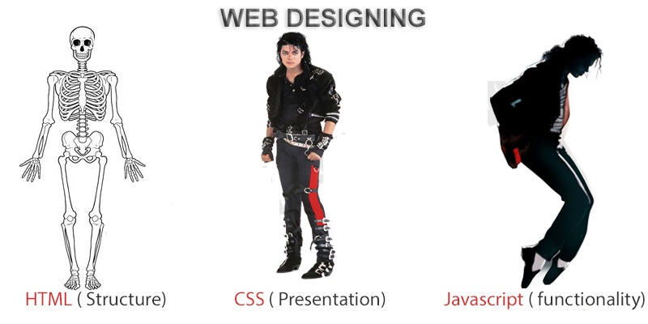
FRONTEND (LANGUAGE USED)
HTML (HYPERTEXT MARKUP LANGUAGE)
CSS (CASCADING STYLE SHEET)
BOOTSTRAP (FRAMEWORK OF CSS AND JS)

Slide 18

BACKEND
PYTHON DJANGO
SQLITE (DATABASE)

Slide 19
SYSTEM DESIGN
Unified Modeling Language:
UML stands for Unified Modeling Language. It is a third generation method for specifying, visualizing and documenting the artifacts of an object oriented system under development. Object modeling is the process by which the logical objects in the real world (problem space) are represented (mapped) by the actual objects in the program (logical or a mini world). This visual representation of the objects, their relationships and their structures is for the ease of understanding. This is a step while developing any product after analysis.

Slide 20
The Unified Modeling Language encompasses a number of models.
Use case diagrams
Class diagrams
Sequence diagrams

Slide 21
Use Case Diagram:
Use case diagram consists of use cases and actors and shows the interaction between them. The key points are:
The main purpose is to show the interaction between the use cases and the actor.
To represent the system requirement from user’s perspective.
The use cases are the functions that are to be performed in the module.
An actor could be the end-user of the system or an external system.

Slide 22
Use Case Diagram – Admin :
Dashboard
Donation Management
Manage Donor (view and delete)
Manage Volunteer
Manage Donation Area
Change Password

Slide 23
Use Case Diagram - Donor User:
Donate Items
View My Donation History
Update Profile
Change Password

Slide 24
Use Case Diagram - Volunteer User:
View Donation Collection Req.
View Donation History
Update Profile
Change Password

Slide 25
Sequence Diagram:
The purpose of sequence diagram is to show the flow of functionality through a use case. In other words, we call it a mapping process in terms of data transfers from the actor through the corresponding objects.

Slide 26
SEQUENCE DIAGRAM

Slide 27
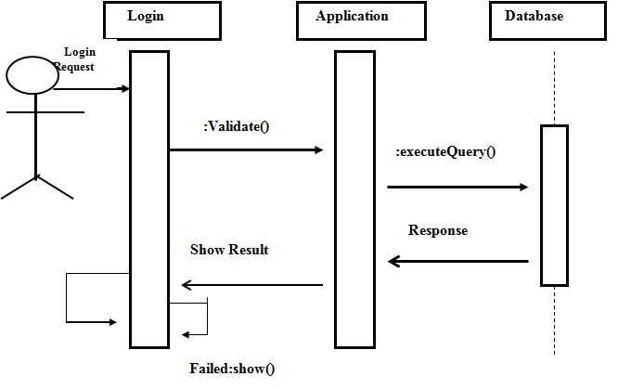
Sequence Diagram For Administrator:-

Slide 28
Admin flow chart
Login
Accept the request from donor
Appoint Volunteer as per location
Monitor the progress of Volunteer
Update the database

Slide 29
Donor flow chart
Login
Select Donation Type
Fill Donation Form
Submit

Slide 30
Volunteer flow chart
Login
Accept Donation Collection Req.
Update Donation Status
Upload Donation PIC
Submit

Slide 31
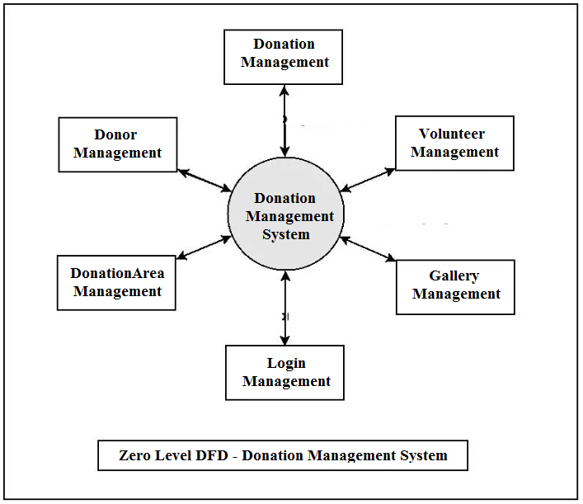
Data Flow Diagram(DFD)

Slide 32
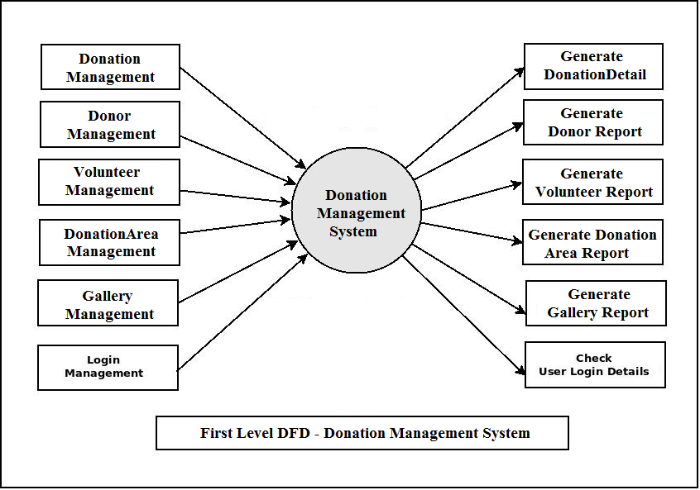
Data Flow Diagram(DFD)

Slide 33
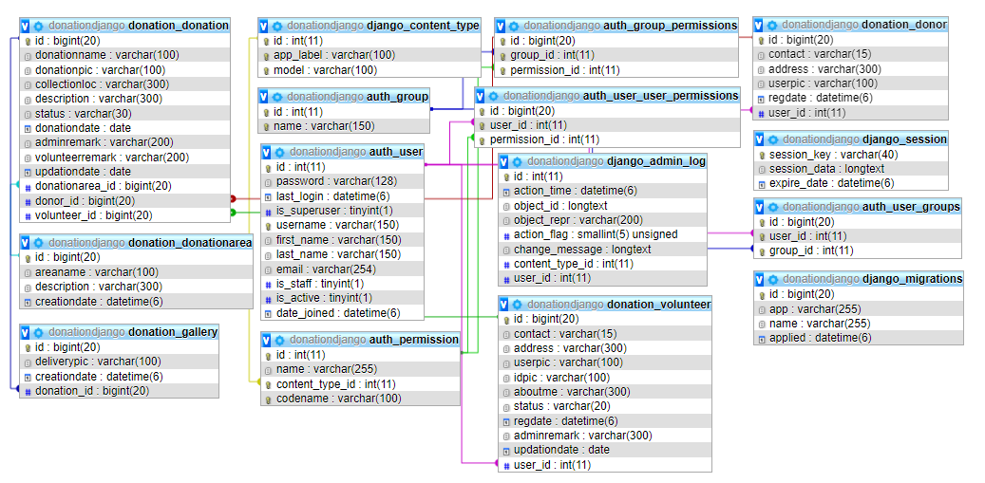
Class Diagram

Slide 34
ER Diagram

Slide 35
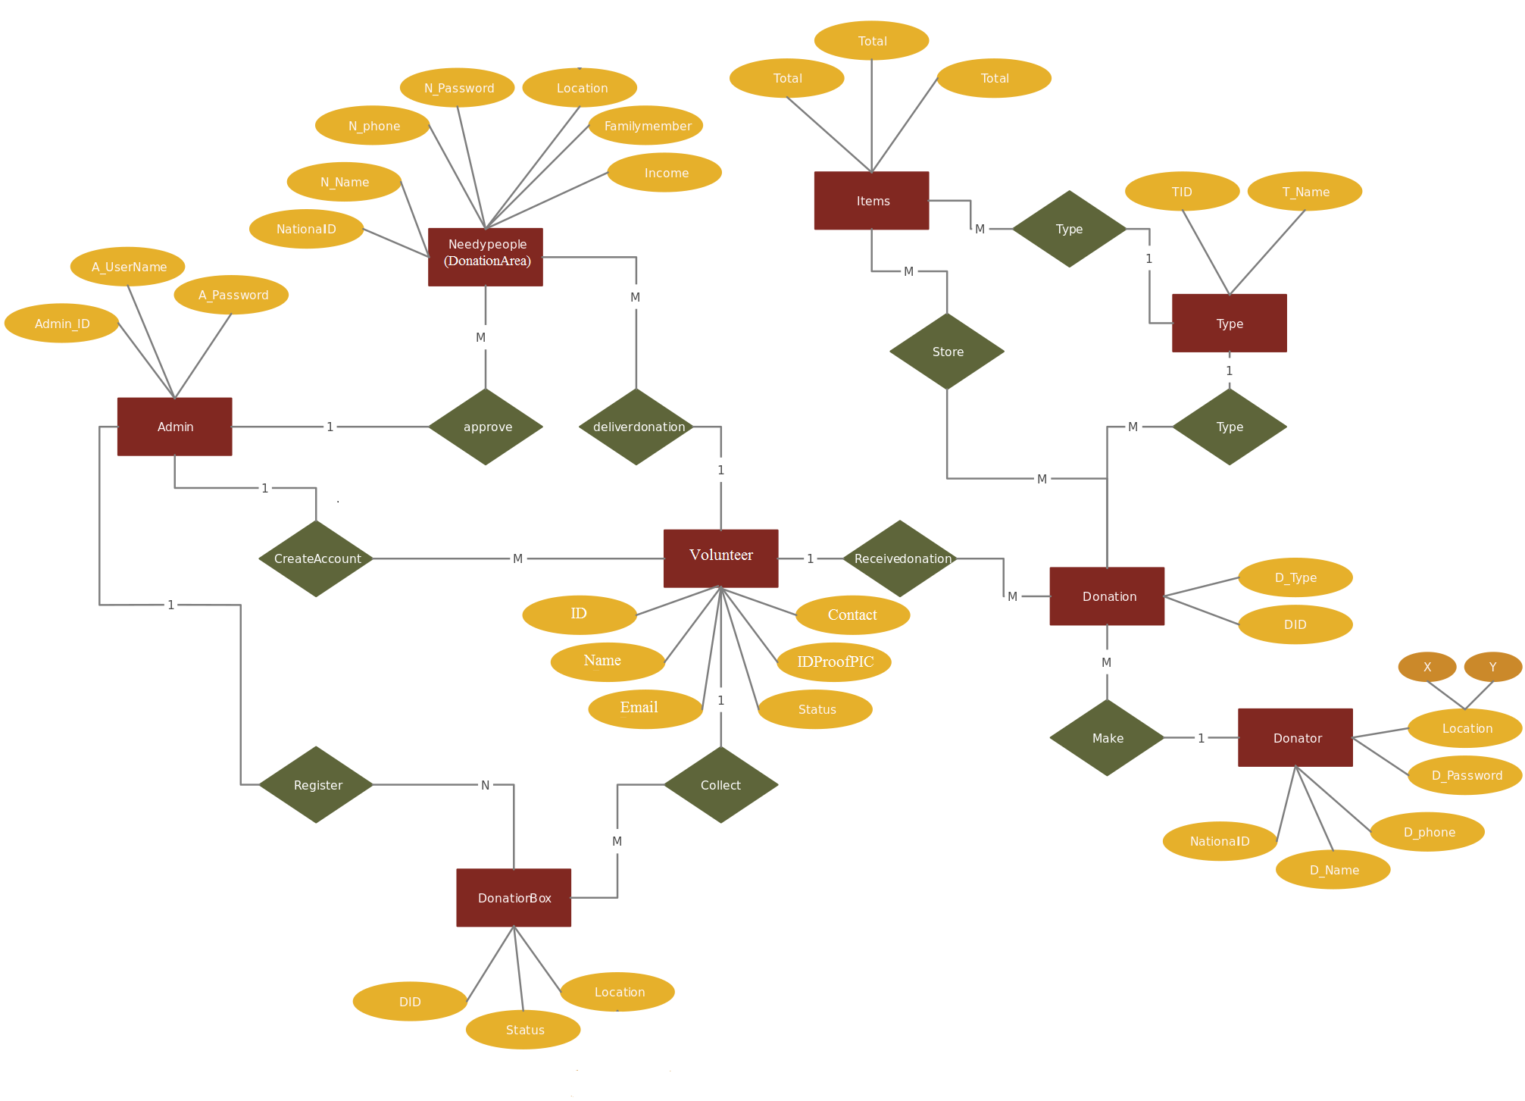

Slide 36
SCREEN SHOTS

Slide 37
FUTURE SCOPE
This web application involves almost all the basic features of the online donation management system. The future implementation will be online help for the users and chatting with website administrator.

Slide 38
CONCLUSION
It has been a great pleasure for me to work on this exciting and challenging project. This project proved good for me as it provided practical knowledge of not only programming in Python and Sqlite web based application. It also provides knowledge about the latest technology used in developing web enabled application and client server technology that will be great demand in future. This will provide better opportunities and guidance in future in developing projects independently.

Slide 39
BIBLIOGRAPHY
FOR PYTHON INSTALLATION
https://www.python.org
FOR HTML , CSS ANF PYTHON BASICS
www.w3schools.com
www.javatpoint.com
https://www.geeksforgeeks.org/python-django/
REFERENCE BOOKS
Two scoops of Django for 1.11 by Daniel Greenfeld’s and Audrey Greenfield
Lightweight Django by Elman and Mark Lavin

Slide 40
THANKYOU

